Slide 1


Author: Doris Amoakohene Supervisor: Toby Hocking Co-Worker: Anirban Chetia
Outline of Presentation
Introduction
Visualizing the atime result of various functions with data.table
Visualizing the atime result for performance regression
GitHub Action
Conclusion
1
2
3
4
Title: Benchmarking Performance for the data.table Package
5

Slide 2


1: Introduction
Comparative Benchmarking: Comparing data.table to other packages in R and python that perform similar tasks
data.table
VRS
pandas
data.table
VRS
Other R packages
Performance Testing: We evaluate the performance of different versions of the data.table repository by benchmarking their memory and time usage.
fast
commit
slow
fixed
fast

Slide 3
1: Introduction
Comparative Benchmarking: Comparing data.table to other packages in R and python that perform similar tasks
data.table
VRS
pandas
data.table
VRS
Other R packages
Performance Testing: We evaluate the performance of different versions of the data.table repository by benchmarking their memory and time usage.
fast
commit
slow
fixed
fast

Slide 4
1: Introduction - Benchmarking Methods
 | project | N (data size) | GitHub action | Visualizing of result
airspeed velocity | python | Single N value | Print result on a webpage | No
Conbench | arrow | Single N value | - | No
Touchstone | R | Single N value | Comment in GitHub Pull Requests. | No
pytest-benchmark | Python projects with pytest | Single N value | Benchmark results are visualized on the GitHub pages of your project. | No
atime(proposed, not only for data.table but other packages as well) | data.table and other R packages | Sequence of N values | Comments the generated results on pull requests. | Yes

Slide 5
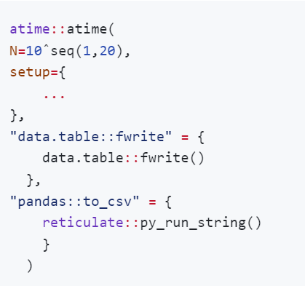
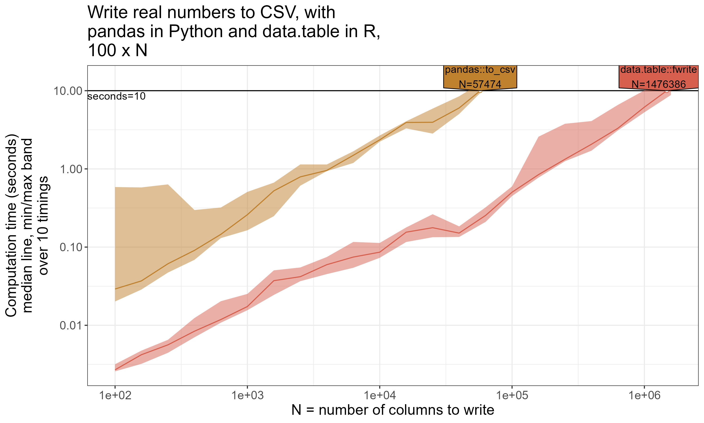
2. Visualizing the atime result of various functions with data.table

Slide 6
2. Visualizing the atime result of various functions with data.table

Slide 7
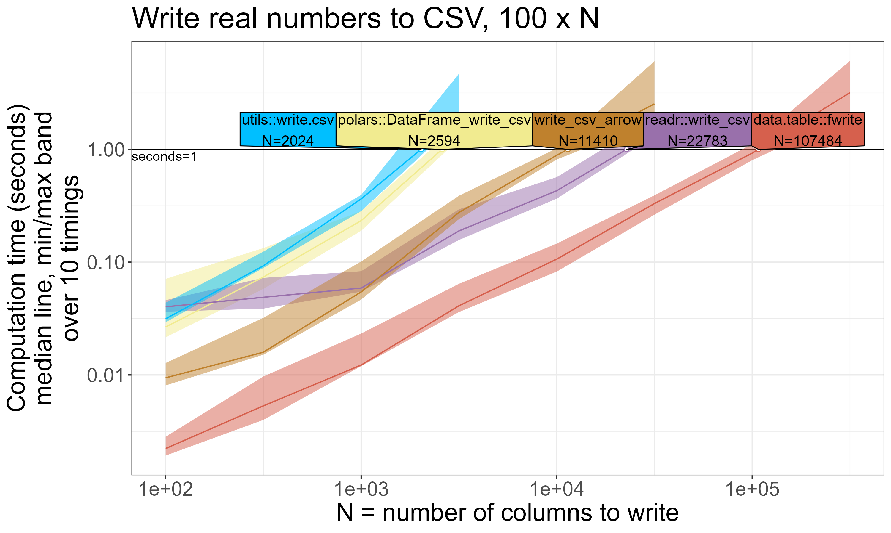
2: Comparative Benchmarking Results

Slide 8
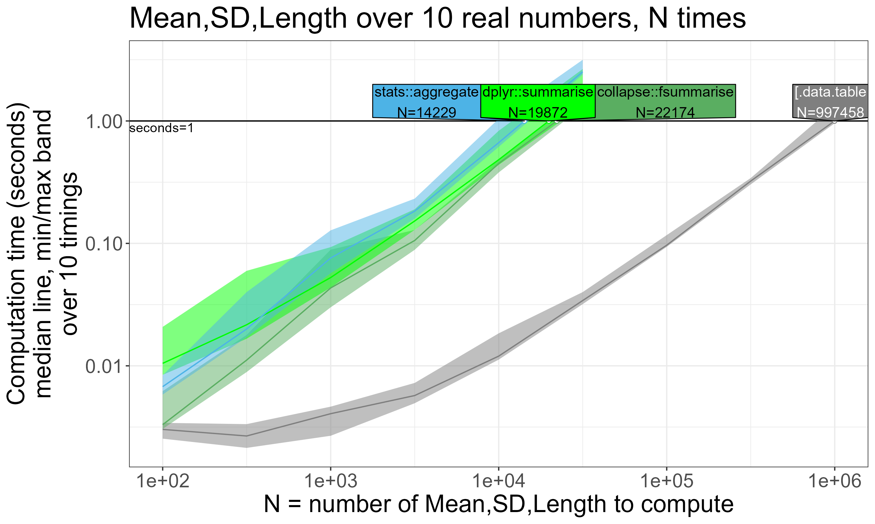
2: Comparative Benchmarking Results

Slide 9
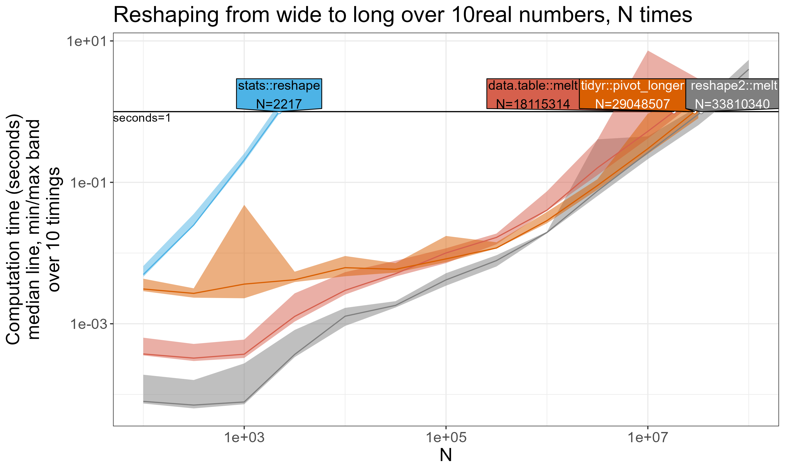
2: Comparative Benchmarking Results

Slide 10
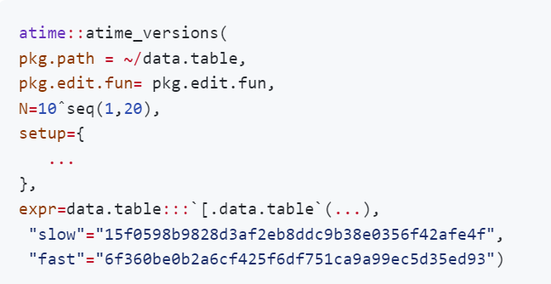
3. Visualizing the atime result for performance regression
Path to git clone of repo containing R package(data.table).
function called to edit package before installation

Slide 11
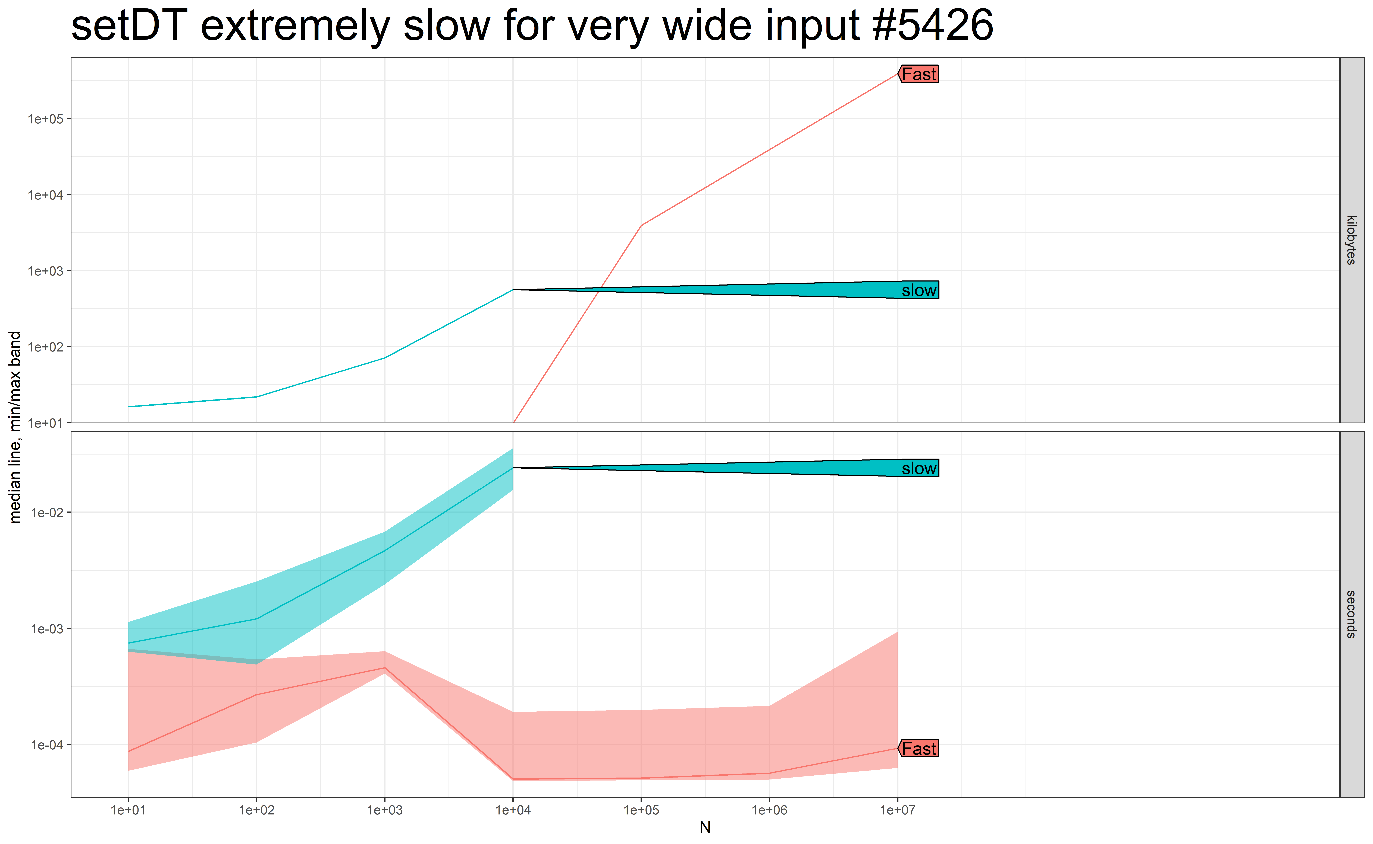
3: Performance Testing Result

Slide 12
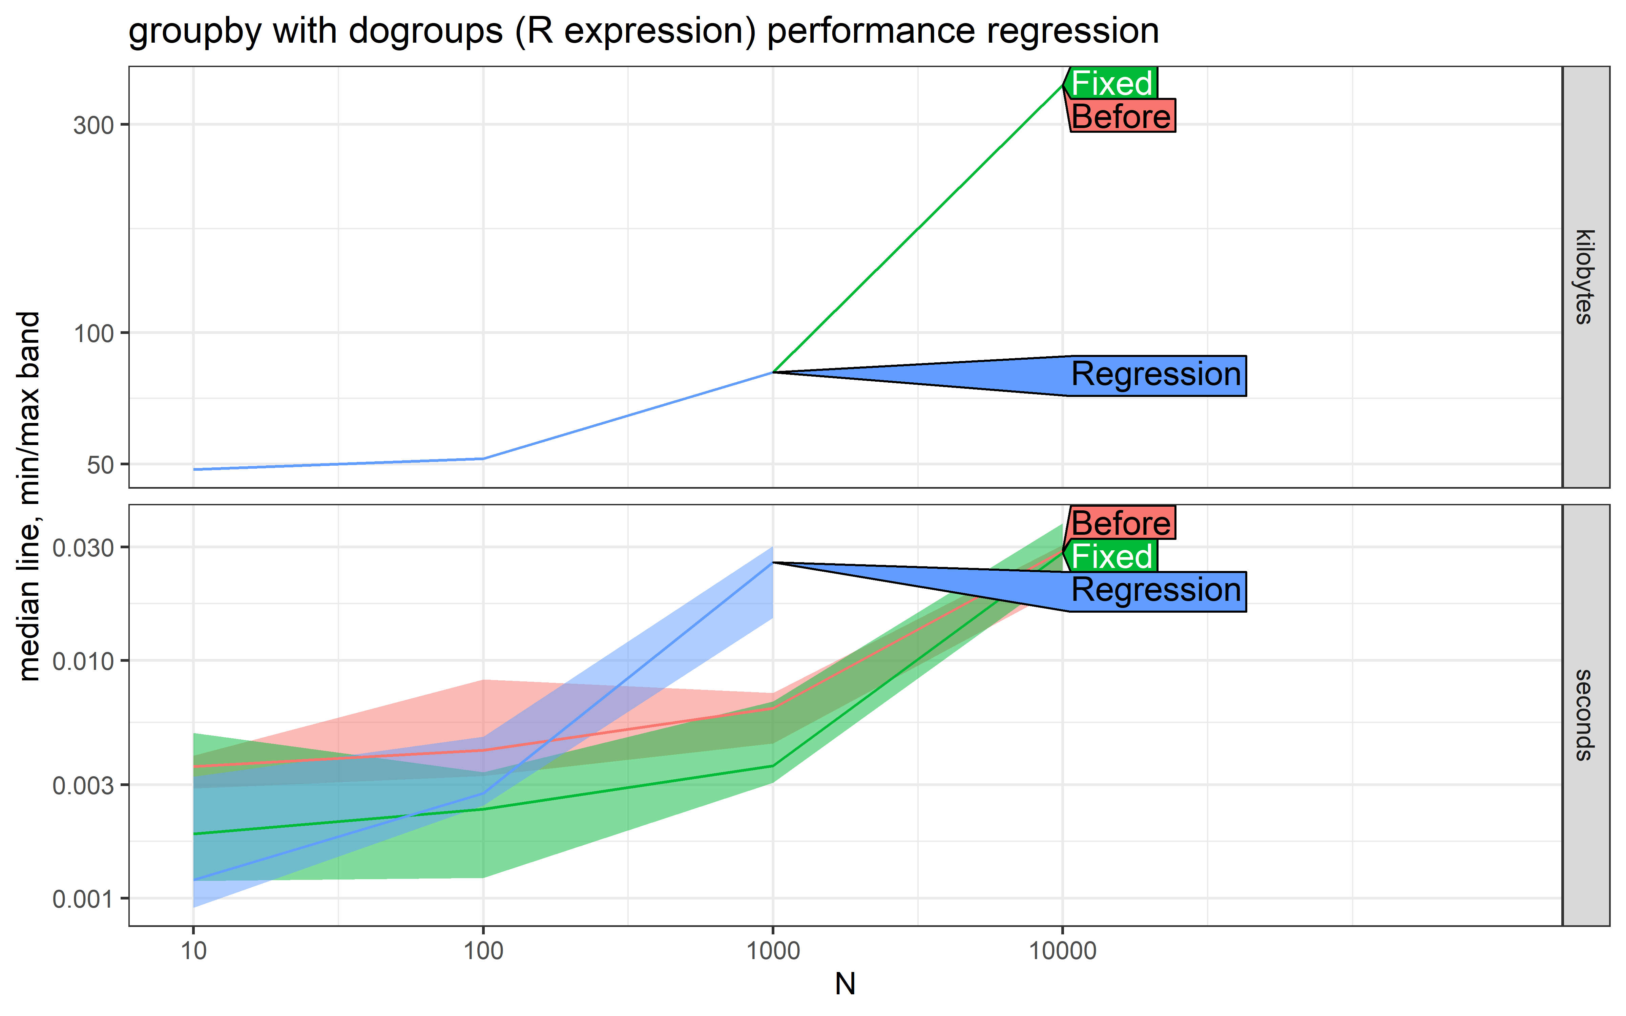
3: Performance Testing Result

Slide 13
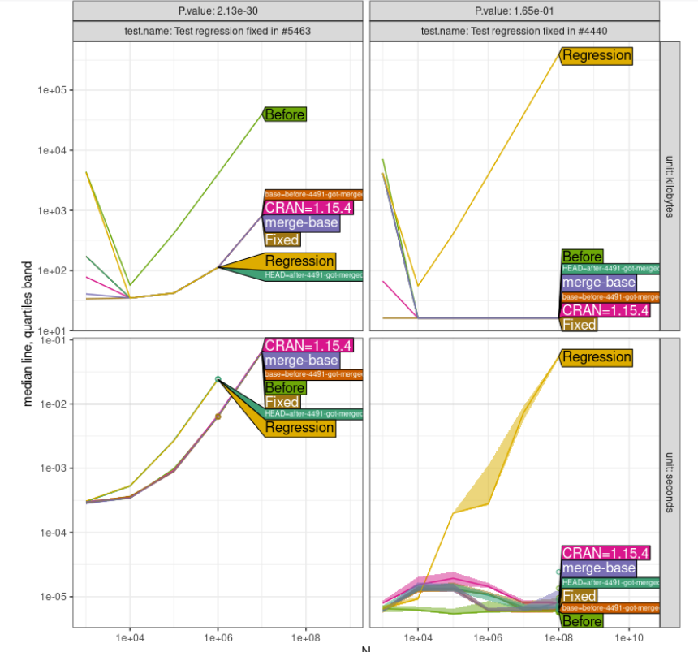
Source: @Anirban16, GitHub
4: GitHub Action
GitHub Action

Slide 14
Source: @Anirban16, GitHub
4: GitHub Action
GitHub Action

Slide 15

data.table is an efficient package for data manipulation.
atime package proves to be exceptionally useful for conducting comparative benchmarking and performance testing.
5: Conclusion

